Slide 1
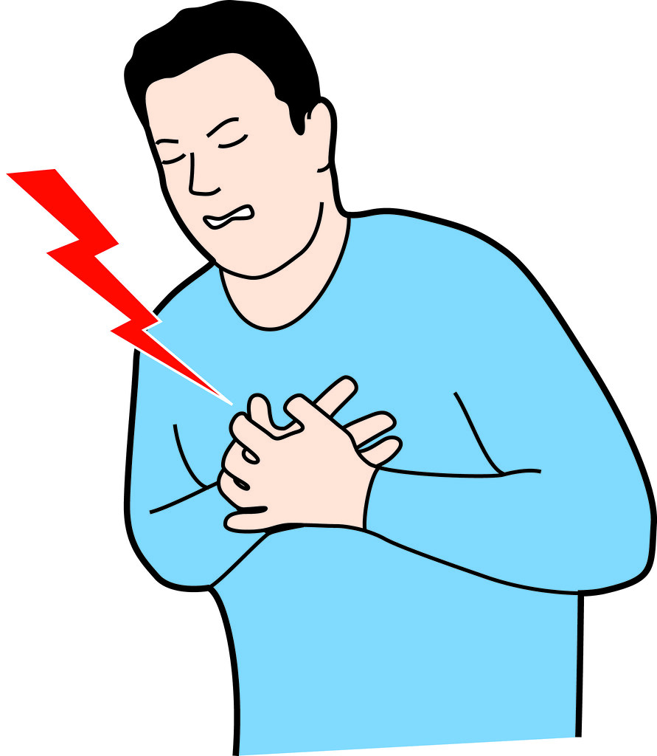
Say it with ya chest
Exploring the correlation between chest pain and cardiovascular disease

Slide 2
Cardiovascular disease is the #1 cause of death in the world
Background

Slide 3
Significant strides have been made in terms of the tests that exist to detect the presence of cardiovascular disease
Background

Slide 4
But the only potential signal of cardiovascular disease that does not require a test is a patient’s chest pain (angina)
Background

Slide 5

This analysis…
Explore the correlation between chest pain and cardiovascular disease
Identify factors that when confounded with chest pain become stronger indicators of cardiovascular disease
Determine if the identifies trends are effected by sex

Slide 6
Data
Obtained from the UCO Machine Learning repository
297 patients from the Cleveland Clinic Foundation (14 Predictors)
Age
Sex
Chest pain
Resting blood pressure
Serum cholesterol in mg/dl
Fasting blood sugar > 120 mg/dl
Resting electrocardiographic results (values 0,1,2)
Maximum heart rate achieved
Exercise induced angina
Oldpeak = ST depression induced by exercise relative to rest
The slope of the peak exercise ST segment
Number of major vessels (0-3) colored by fluoroscopy
Thal: 0 = normal; 1 = fixed defect; 2 = reversable defect
Target: 0= less chance of heart attack 1= more chance of heart attack

Slide 7
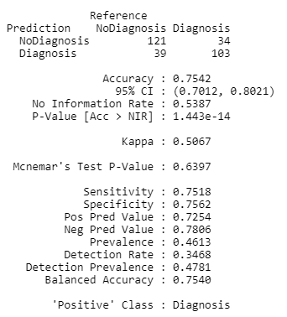
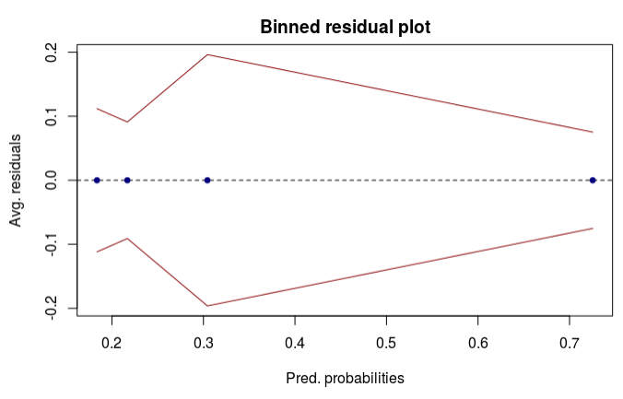
Early conclusions
Is chest pain an accurate signal of heart disease? What if it is exercise induced?

Slide 8
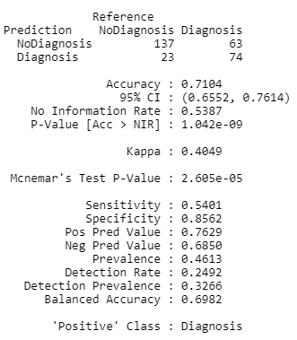
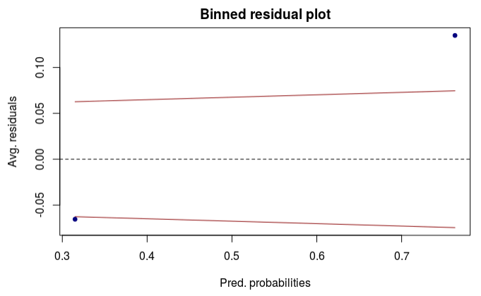
Early conclusions
Is chest pain an accurate signal of heart disease? What if it is exercise induced?

Slide 9
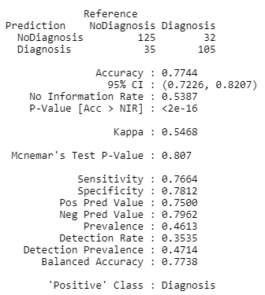
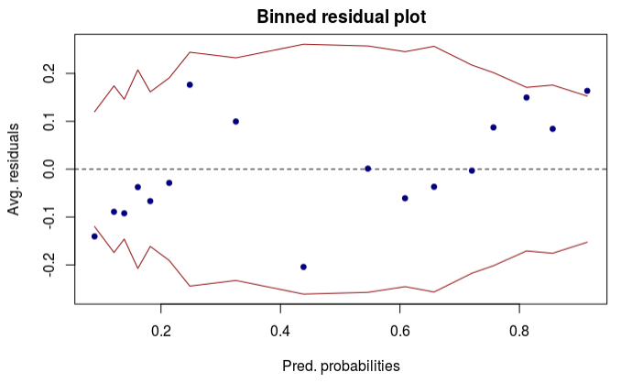
Early conclusions
Is the persistence of chest pain more significant if a patient has other confounding factors?

Slide 10
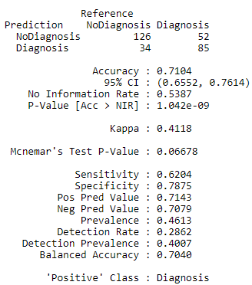
Early conclusions
Is the persistence of chest pain more significant if a patient has other confounding factors?

Slide 11
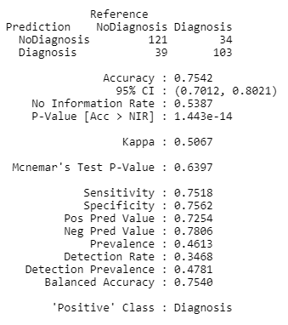
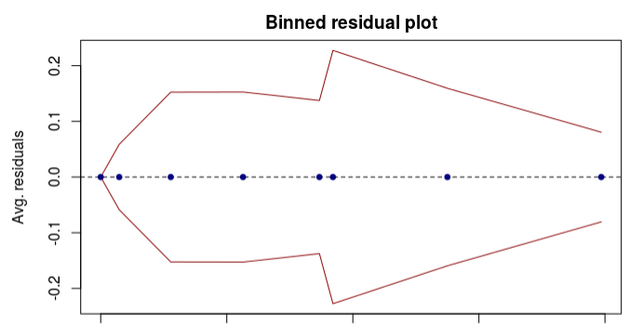
Early conclusions
How do these effects compare for both men and women?

Slide 12
Summarizing the early resutls
Chest pain alone achieves a sensitivity of 0.75, a specificity of 0.75, and a accuracy of 0.75
Exercise induced chest pain alone achieves a sensitivity of 0.54, a specificity of 0.85, and a accuracy of 0.70
Modeling with the interaction between exercise-induced and non exercise induced chest pain, the model performs identical to the model with chest pain alone.

Slide 13
Summarizing the early resutls
When thalach (maximum heart rate achieved) is included in the model with chest pain we see an improved sensitivity of 0.77, a specificity of 0.78, and an accuracy of 0.77
When oldpeak (maximum heart rate achieved) is included in the model with chest pain along with the interaction term, we see an improved sensitivity of 0.65, a specificity of 0.83, and an accuracy of 0.75.
  In this case the specificity improves while specificity worsens – however, in this context….
  a false negative is worse than a false positive so this is good
  Sex does not appear to effect the relationship between chest pain and cardiovascular disease

